Slide 1





Iterators and Comparators
C# OOP
Advanced
SoftUni Team
Technical Trainers
Software University
http://softuni.bg

Slide 2

Table of Contents
Design Patterns
Iterator Pattern
Iterators
IEnumerable<T> interface
yield return
params
Comparators
IComparable<T> interface
IComparer<T> interface

Slide 3
Questions
sli.do #CSharp-OOP

Slide 4

Design Patterns
Iterator Pattern

Slide 5
Design Patterns
General repeatable solution to a commonly occurring problem in software design
Providing tested, proven development paradigms
Improves code readability for developers already familiar with the patterns

Slide 6
Iterator Pattern
Client
Collection
+ createTraversalObject() :
TraversalAbstraction
TraversalAbstraction
+ first()
+ next()
+ isDone()
Concrete Collection
+ createTraversalObject()
Concrete Traversal
+ first()
+ next()
+ isDone()

Slide 7
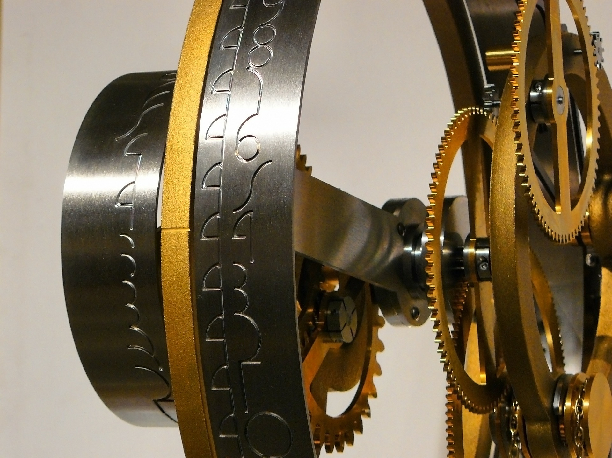
Iterators
IEnumerable<T> and IEnumerator<T>

Slide 8
IEnumerable<T>
Root interface of .NET, enables simple iteration over a collection
Contains a single method GetEnumerator(), which returns an IEnumerator<T>
A class that implements the IEnumerable<T> can be used in a foreach loop traversal

Slide 9
IEnumerable<T> Example
public interface IEnumerable<T> : IEnumerable
{
IEnumerator<T> GetEnumerator();
}
// Non-generic version (compatible with the legacy .NET 1.1)
public interface IEnumerable
{
IEnumerator GetEnumerator();
}

Slide 10
IEnumerator<T>
Provides the sequential, forward-only iteration over a collection of any type
Methods
MoveNext() - advances the enumerator to the next element of the collection.
Reset() - sets the enumerator to its initial position
Properties
Current – returns the element in the collection at the current position of the enumerator

Slide 11
IEnumerator<T> - Example
public interface IEnumerator<T> : IEnumerator
{
bool MoveNext();
void Reset();
T Current { get; }
}
public interface IEnumerator
{
bool MoveNext();
void Reset();
object Current { get; }
}

Slide 12
Yield Return
Indicates that the member in which it appears is an iterator
Simplifies the IEnumerator<T> implementations
Returns one element upon each loop cycle
private readonly List<Book> books;
public IEnumerator<Book> GetEnumerator()
{
for (int i = 0; i < this.books.Count; i++)
yield return this.books[i];
}

Slide 13
Params
Takes a variable number of arguments
Only one params keyword is allowed in a method declaration
Should always be last
PrintNames("Pesho", "Stamat", "Jivko", "Stavri");
public static void PrintNames(params string[] names)
{
foreach(var name in names)
Console.WriteLine(name);
}

Slide 14

Exercise in Class - Iterators

Slide 15
Problem: Library Iterator
Create a class Library which should store a collection of books and implement the IEnumerable<Book> interface
Book
<<IEnumarable<Book>>>
Library
+ Title: string
+ Year: int
+ Authors: List<string>
- books: List<Book>

Slide 16
Problem: Library Iterator (2)
Inside the Library class create nested class LibraryIterator, which implements IEnumerator<Book>
<<IEnumerator<Book>>>
LibraryIterator
-currentIndex: int
-books: List<Book>
+ Current: Book
+Reset(): void
+MoveNext(): bool
+Dispose(): void

Slide 17
Solution: Library Iterator
public class Book
{
public Book(string title, int year, params string[] authors)
{
this.Title = title;
this.Year = year;
this.Authors = authors;
}
public string Title { get; private set; }
public int Year { get; private set; }
public IReadOnlyList<string> Authors
{ get; private set; }
}

Slide 18
Solution: Library Iterator (2)
public class Library : IEnumerable<Book>
{
private List<Book> books;
public Library(params Book[] books)
{
this.books = new List<Book>(books);
}
public IEnumerator<Book> GetEnumerator()
{
return new LibraryIterator(this.books);
}
IEnumerator IEnumerable.GetEnumerator()
=> this.GetEnumerator();
}

Slide 19
Solution: Library Iterator (3)
private class LibraryIterator : IEnumerator<Book>
{
private readonly List<Book> books;
private int currentIndex;
public LibraryIterator(IEnumerable<Book> books)
{
this.Reset();
this.books = new List<Book>(books);
}
public void Dispose(){}
public bool MoveNext()
=> ++this.currentIndex < this.books.Count;
public void Reset() => this.currentIndex = -1;
public Book Current => this.books[this.currentIndex];
object IEnumerator.Current => this.Current;
}

Slide 20
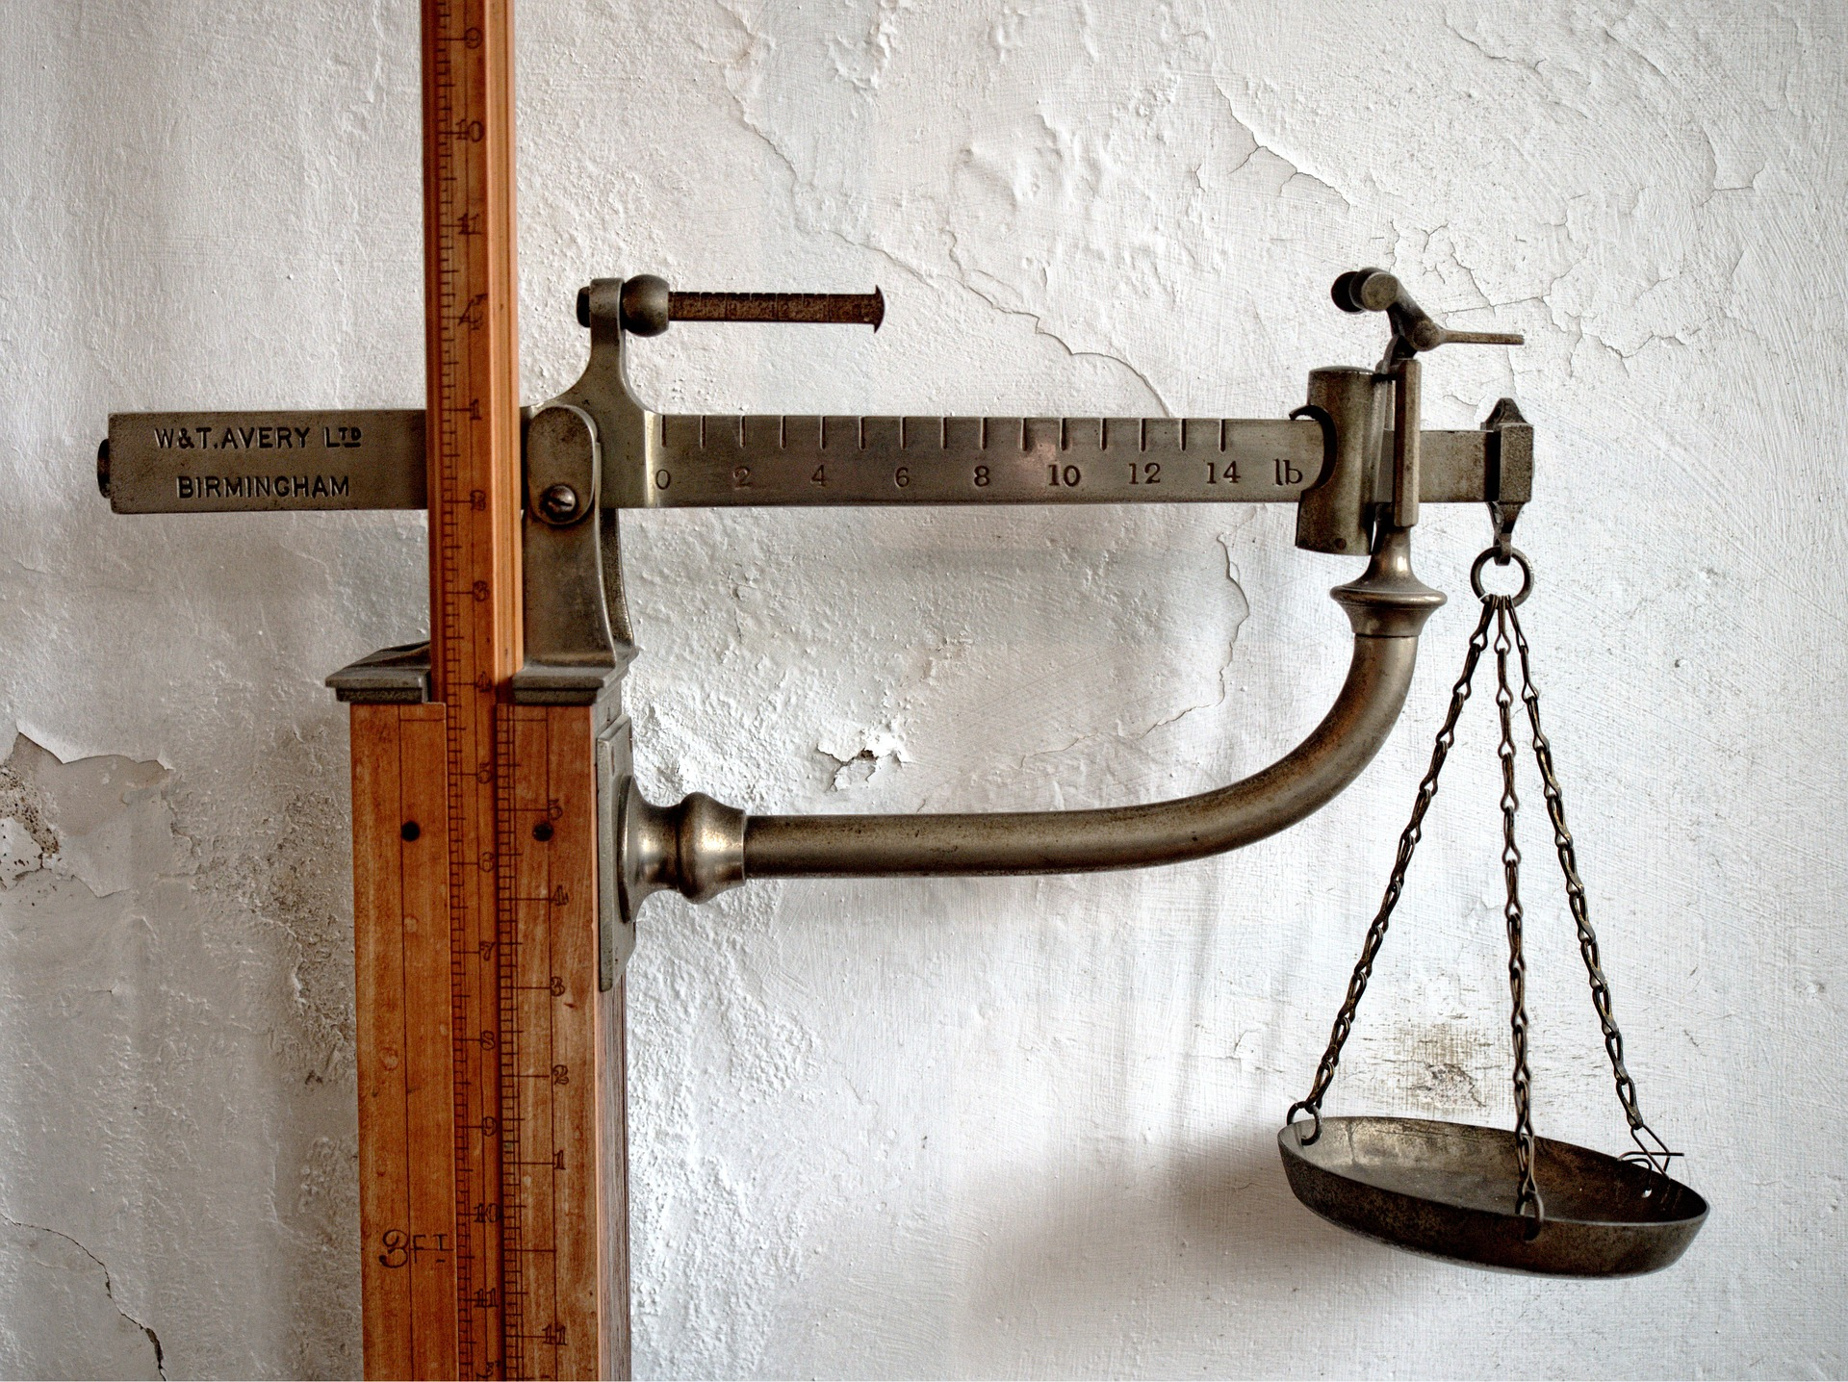
Comparators
IComparable<T> and IComparer<T>

Slide 21
IComparable<T>
Reads out as “I am Comparable”
Provides a method of comparing two objects of a particular type – CompareTo()
Sets a default sort order for the particular objects type
Affects original class

Slide 22






CompareTo(T) Method Returns
< 0
= 0
> 0
Notes:
CompareTo(T) method returns:
Number < 0 – if the passed object is bigger than this object
Number = 0 – if the passed object is equal to this object
Number > 0 – if the passed object is smaller than this object

Slide 23
IComparable<T> – Example
class Point : IComparable<Point>
{
public int X { get; set; }
public int Y { get; set; }
public int CompareTo(Point otherPoint)
{
if (this.X != otherPoint.X)
return (this.X - otherPoint.X);
if (this.Y != otherPoint.Y)
return (this.Y - otherPoint);
return 0;
}
}

Slide 24
IComparable<T> - Example 2
class Cat : IComparable<Cat>
{
public string Name { get; set; }
public int CompareTo(Cat other)
{
return this.Name.CompareTo(other.Name);
}
}

Slide 25
IComparer<T>
Reads out as “I Compare”
Provides a way to customize the sort order of a collection
Defines a method that a type implements to compare two objects
Doesn’t affect original class

Slide 26
IComparer<T> - Example
class CatComparer : IComparer<Cat>
{
public int Compare(Cat x, Cat y)
{
return x.Name.CompareTo(y.Name);
}
}
IComparer<Cat> comparer = new CatComparer();
SortedSet<Cat> catsByName = new SortedSet(comparer);

Slide 27
Exercises in Class - Comparators

Slide 28
Problem: Comparable Book
Implement the IComparable<Book> interface in the existing class Book.
First sort them in ascending chronological order (by year)
If two books are published in the same year, sort them alphabetically
Override the ToString() method in your Book class so it returns a string in the format:
{title} - {year}
Change your Library class so that it stores the books in the correct order.

Slide 29
Solution: Comparable Book
public class Book : IComparable<Book>
{
public int CompareTo(Book other)
{
int result = this.Year.CompareTo(other.Year);
if (result == 0)
{
result = this.Title.CompareTo(other.Title);
}
return result;
}
}

Slide 30
Problem: Book Comparer
Create a class BookComparator which should implement the IComparer<Book> interface
BookComparator must compare two books by:
Book title - alphabetical order
Year of publishing a book - from the newest to the oldest
Modify your Library class once again to implement the new sorting

Slide 31
Solution: Book Comparer
public class BookComparator : IComparer<Book>
{
public int Compare(Book x, Book y)
{
int result = x.Title.CompareTo(y.Title);
if (result == 0)
{
result = y.Year.CompareTo(x.Year);
}
return result;
}
}

Slide 32

Summary
Iterators
IEnumerable<T> interface
IEnumerator<T> interface
yield return
Params
Comparators
IComparable<T> interface
IComparer<T> interface

Slide 33







Iterators and Comparators
https://softuni.bg/courses/advanced-csharp

Slide 34

License
This course (slides, examples, demos, videos, homework, etc.) is licensed under the "Creative Commons Attribution-NonCommercial-ShareAlike 4.0 International" license
Attribution: this work may contain portions from
"Fundamentals of Computer Programming with C#" book by Svetlin Nakov & Co. under CC-BY-SA license
"OOP" course by Telerik Academy under CC-BY-NC-SA license

Slide 35






Free Trainings @ Software University
Software University Foundation – softuni.org
Software University – High-Quality Education, Profession and Job for Software Developers
softuni.bg
Software University @ Facebook
facebook.com/SoftwareUniversity
Software University @ YouTube
youtube.com/SoftwareUniversity
Software University Forums – forum.softuni.bg

